Slide 1
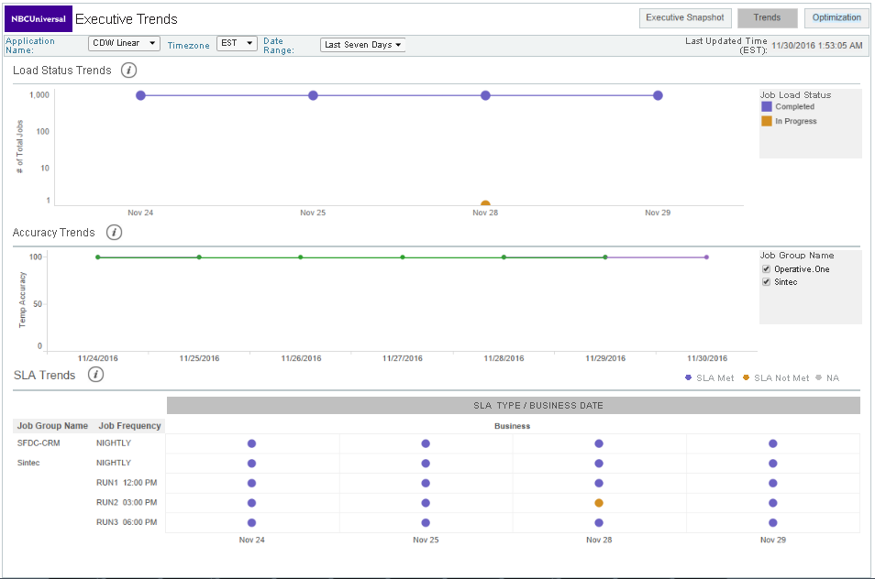
EACS Dashboard – Data Availability, Accuracy and SLA Status Trend Analysis
Data Load Trend
Data Accuracy Trend
SLA Status Trend

